Slide 1
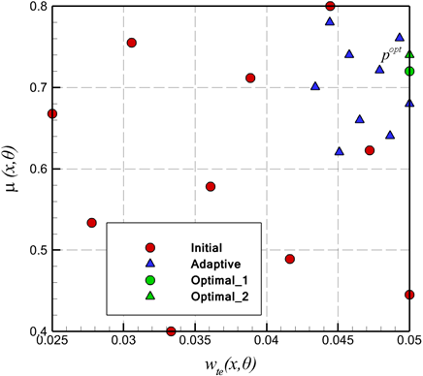
Surrogate-based optimization method with adaptive sampling
Hakim T. Kadhim | Aldo Rona | Hakim T. Kadhim
University of Leicester hkk10@leicester.ac.uk | University of Leicester ar45@leicester.ac.uk | Al-Dewaniyah Technical Institute, Al-Furat Al-Awsat Technical University Hakim.Kadhim@yahoo.com
Summary
In this work, a surrogate based optimization method with and without adaptive sampling is presented. For the design of experiment, the Optimal Latin Hypercube method is used. This is combined with Kriging modelling (KRG), which provides a surrogate model for the engineering performance (functional performance) of the item being designed. The Kriging model is selected as it can give a good compromise between the solution cost and the prediction accuracy. The low cost overhead of the Kriging model and its robustness are attractive for accelerating the design iterations used in industry.
into the surrogate model by performing numerical experiments by the workflow shown in Fig. 1 [1]. Each numerical experiment samples the parameter space of the endwall and returns a value of the total pressure loss.
Implementation of the optimization
process
Create parametrized geometry in MATLAB
Start
Fig.2. Initial and adaptive sampling using the OLH.
A newly adaptive sampling technique is presented for obtaining more accurate predictions from Kriging model. The technique is also based on the design of the experiment Optimal Latin Hypercube method. An example application of the technique is given, which provided positive but modest improvements in performance with respect to judiciously selected initial sampling. However, the adaptive sampling technique appears to be an interesting approach in its own right.
Discretize geometry in ANSYS ICEM CFD
Predict flow in OpenFOAM
End
Fig.1. Performance evaluation workflow
References
Design of experiment
In the optimization loop, knowledge is built
Kadhim, H. 2018. Effect of non-axisymmetric casing on flow and performance of an axial turbine. PhD thesis, Department of Engineering, University of Leicester

